Slide 1

Final Project
Group # 7

Slide 2
Ambulance Patient Offload Times (APOT) for the County of Sacramento
Ambulance Patient Offload Times or APOT are wait times experienced by patients taken to an ER via ambulance. The wait is caused by lack of bed to move the patient into and at times lack of staff to care for the patient. Our goal centered in identifying what is influences the extended wait times. Shedding a light on where the problems are will show the parties involved where to look and help initiate a plan to alleviate the current situation.
The questions we hope to answer are:
Which impressions have the longest/shortest APOTs? (Overall and by Hospital codes)
Compare to Postal Codes. Which Postal Code areas experience the highest/lowest APOT times when taken to the hospital via ambulance ?
Which zip codes utilize ambulance transports to the ER the most in 2017-2022?
Wait times per hospital by date/time
Do any patterns arise from the data?

Slide 3
Data Sources
The data selected for this project was obtained from Sacramento County Emergency Medical Services Agency. The data set includes the following data points :
Destination Hospital identifier
Destination Hospital location Latitude and Longitude
Date/Time of Occurrence
Ambulance Patient Offload Time (APOT)
Patient Complaint identifier
Ambulance Agency Identifier
Ambulance Unit identifier
Postal Code of Where call was Originated

Slide 4
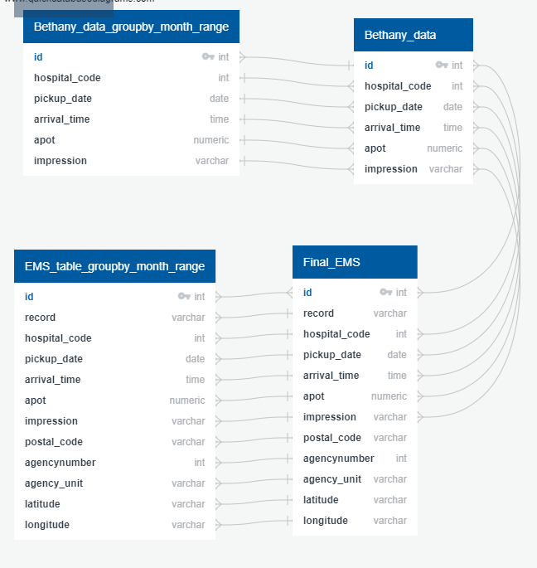
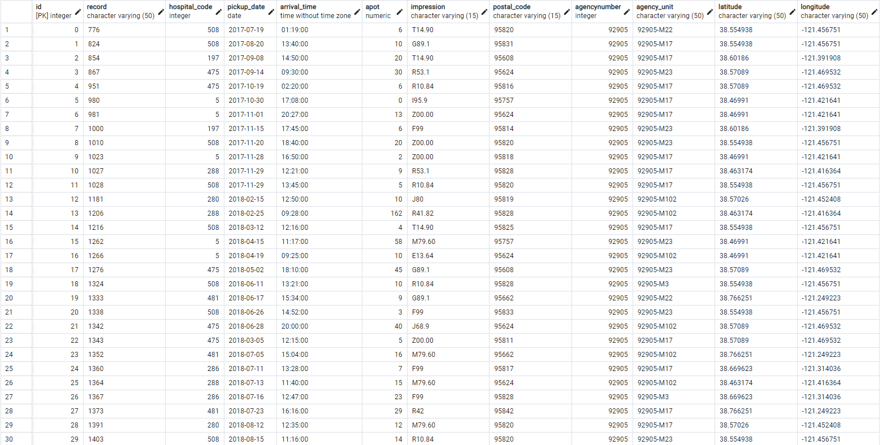
PG Admin was used as the main Database
ERD Diagram
Example of tables

Slide 5



Data Exploration
stratification
Scikit Learn
Training Sets
Through machine learning it was found that there is a strong relationship between APOT and hospital codes. To further explore the data and understand this relationship data is being separated into subgroups of individual hospitals as part of the stratification process.
Linear Regression
Balanced Random Forest Classifier
Easy Ensemble AdaBoost Classifier
Oversampling
SMOTE Oversampling
Under sampling
Combination (Over and Under) Sampling
The testing and training sets are created as Status. The code used for this is below:
• X = df.drop(columns='Status’)
• X = pd.get_dummies(X)
• # Create our target
• y = df[target]

Slide 6
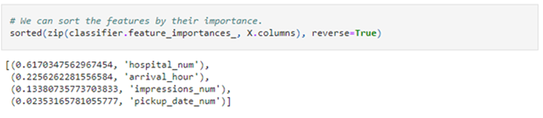
Machine Learning
SkiKit-Learn is the selected Machine Learning Module that will be used during this project. The hosting platform will be utilized on Github. Models and Strategies used include the following:
Linear Regression
Balanced Random Forest Classifier
Easy Ensemble AdaBoost Classifier
Oversampling
SMOTE Oversampling
Undersampling
Combination (Over and Under) Sampling

Slide 7
Top 10 Impressions with the highest APOT waiting for an Emergency Room bed System wide in Sacramento County
Medical Complaint Code | Definition | APOT (H:MM:SS)
Z00.00 | No medical Complaint | 01:06:34
N39.9 | Disorder of Urinary system | 01:05:21
Z77.9 | Hazmat Skin Exposure | 01:02:44
K59.1 | Diarrhea | 0:59:49
I10 | Hypertension | 00:58:33
F99 | Mental Disorder | 00:58:16
R53.1 | General Weakness | 00:57:37
K92.1 | Lower GI Bleed | 00:56:09
I20.9 | Chest Pain Suspected Cardiac | 00:54:21
R41.0 | Agitated Delirium | 00:52:59

Slide 8
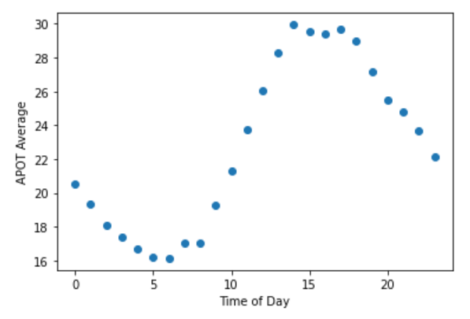
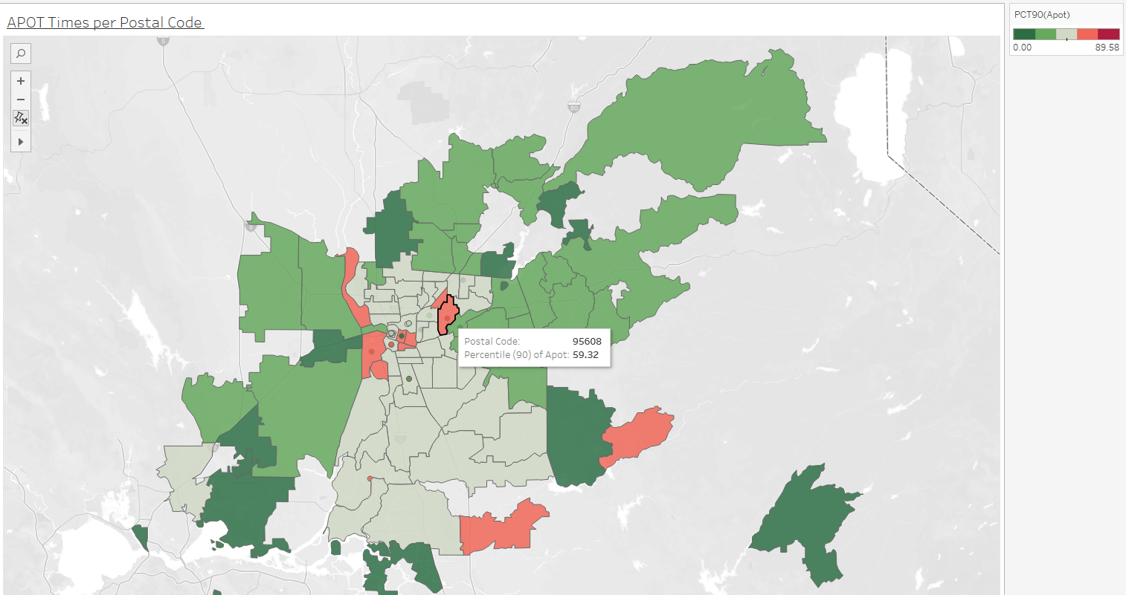
APOT per Hour and Postal Codes with the longest/shortest APOT
System Average APOT per hour
APOT Times per Originating Postal Code

Slide 9
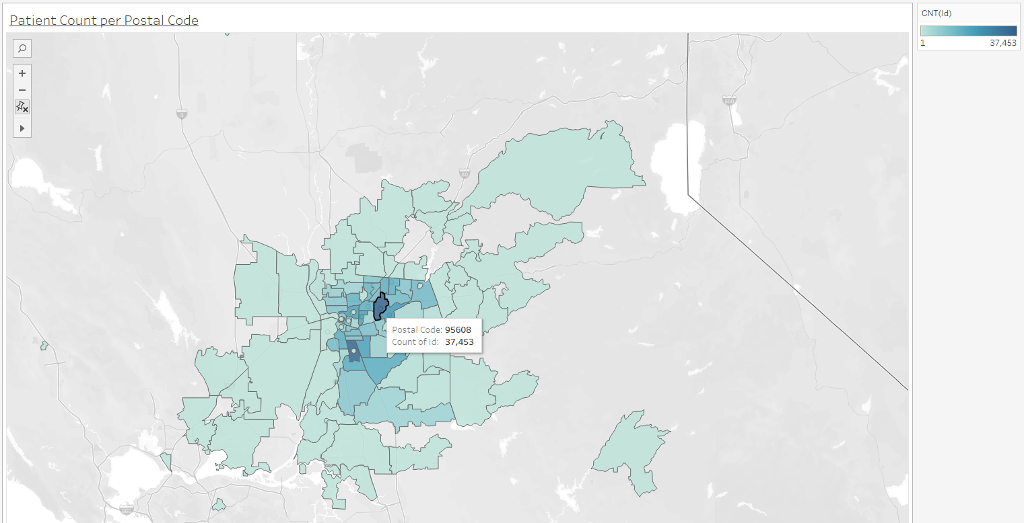
Postal Codes that transport the most Patients via Ambulance

Slide 10
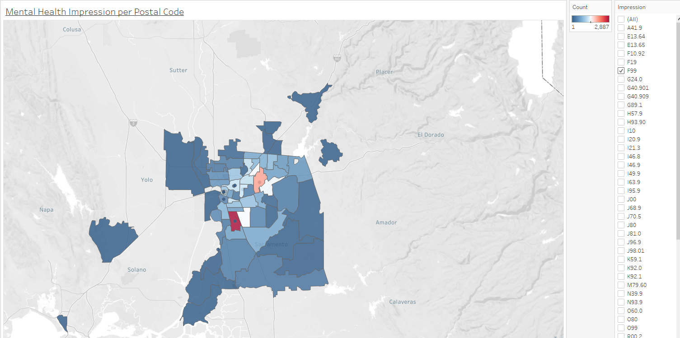
Mental Health Crisis
Mental Health is in the top 10 highest APOT. The greatest number of patients originated from
95608 – Carmichael
95823 – South Sacramento
This present an opportunity for resource allocation that could in turn diminish the number of patients taken to the ER therefor reducing wait times

Slide 11
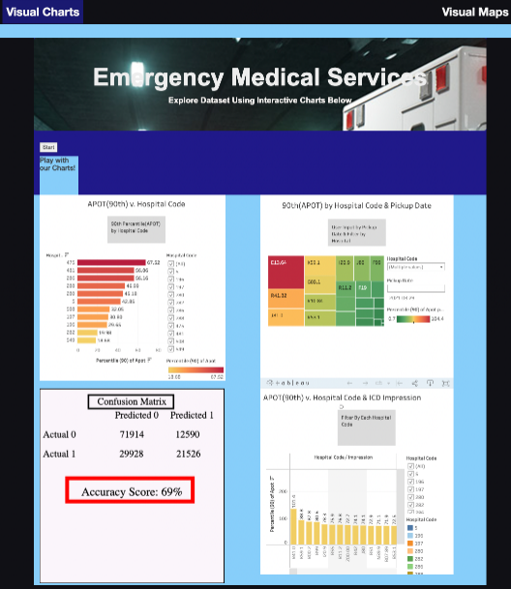
By using the EMS dataset, we will show the relationship of ICD impression codes v. Hospital Code, ICD impression codes v. APOT times, Hospital Code v. APOT times. These relationships will be illustrated graphically, in which users can explore the data using applied filters on each chart. Interactive Elements: Applied filters on each chart
ICD impression codes v. Hospital Code: Hospital Code Filter
ICD impressions v. APOT Times: ICD impression Filter
Hospital Code v. APOT Times: Hospital Code Filter
Other Dashboard Elements:
Confusion Matrix Table
Machine Learning Model Results Table: Accuracy Score, F1 Score, Ranking Importance of Features

Slide 12
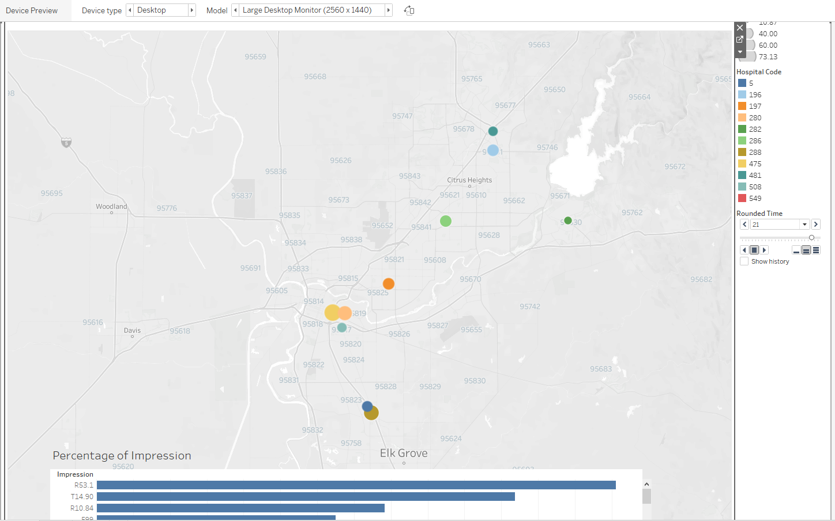
Tableau Link HERE

